Slide 1
real-world scenarios hands-on web application security

Slide 2
Follow along tutorial

Slide 3
Go to: https://pentesterlab.com/exercises/recon-00

Slide 4
Recon 00 (super easy)
Open the hackycorp.com website
Your objective is to find robots.txt
For this you will need basic HTML understanding
Notes:
Recon 00

Slide 5
Notes:
Recon 00

Slide 6
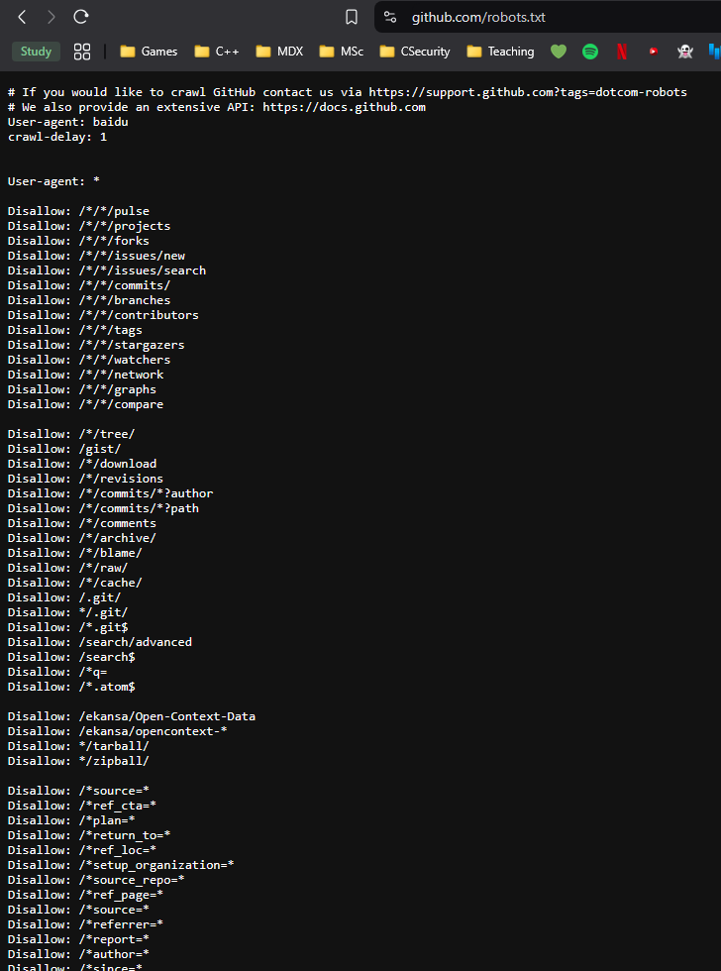
Notes:
Recon 00

Slide 7
Robots.txt
Robots.txt is one of the many preset files public to help people understand specific things, for robots.txt, websites can set out policy information about any bots accessing the website should behave
Notes:
Recon 00

Slide 8
A place for subdirectories
The idea of robots.txt and other useful files, like security.txt, was made to be in a location that is easy to go to and remember.
These files provide essential information for web crawlers and security researchers.
For example, robots.txt tells search engines which pages to crawl, while security.txt offers a standardized way to provide contact information for reporting security vulnerabilities. Both files are placed in the /.well-known/ directory, making them easy to locate for anyone looking for this information. By using this structure, webmasters ensure that key resources are accessible and organized.
Notes:
Recon 00

Slide 9
Key/flag
we used a defined index
Notes:
Recon 00

Slide 10
Enter the flag
Notes:
Recon 00

Slide 11
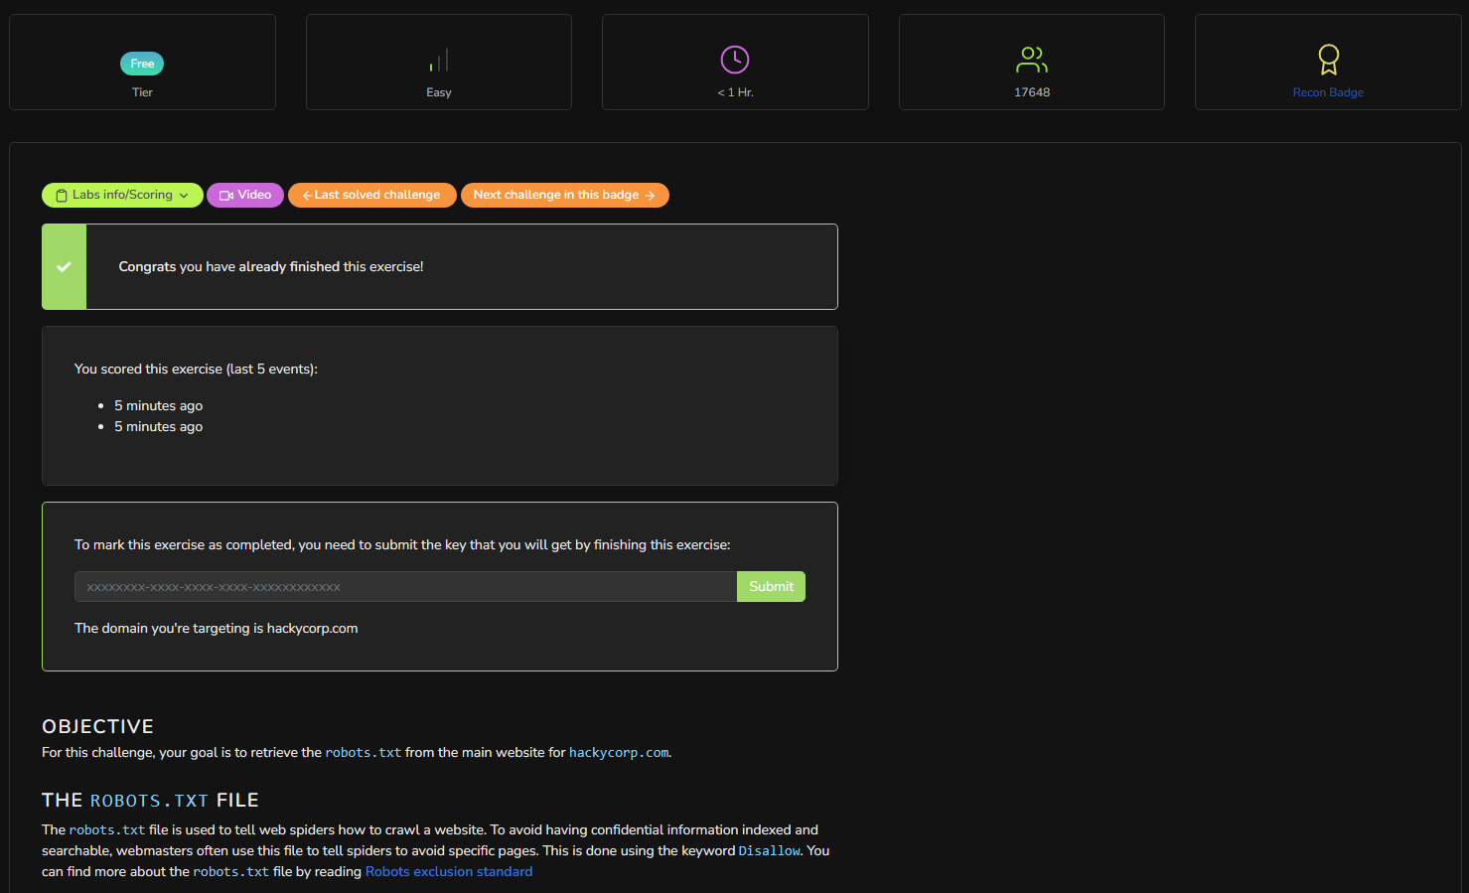
Notes:
Recon 01

Slide 12
Notes:
Recon 01

Slide 13
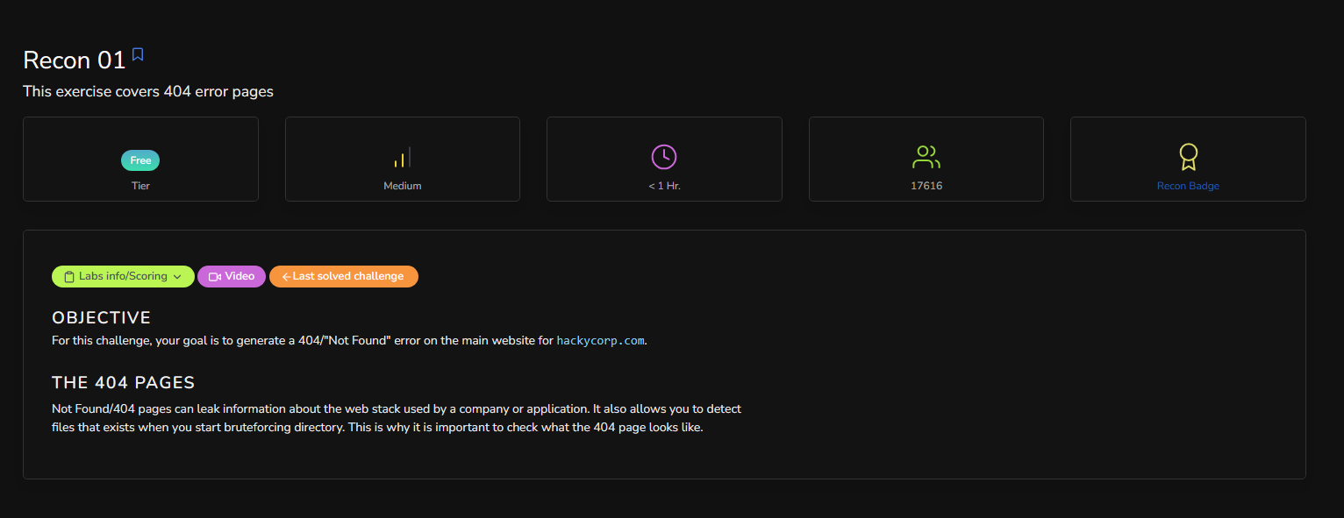
Notes:
Recon 01

Slide 14
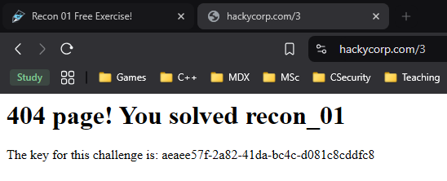
Key/flag
we used a undefined index

Slide 15
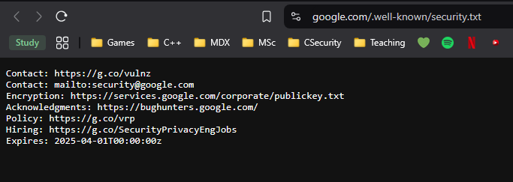
.well-known
Like we mentioned, Security.txt is one of the many files in the .well-known directory
Notes:
Recon 02

Slide 16
Key/flag
we used a defined index inside the .well-known directory
Notes:
Recon 02

Slide 17
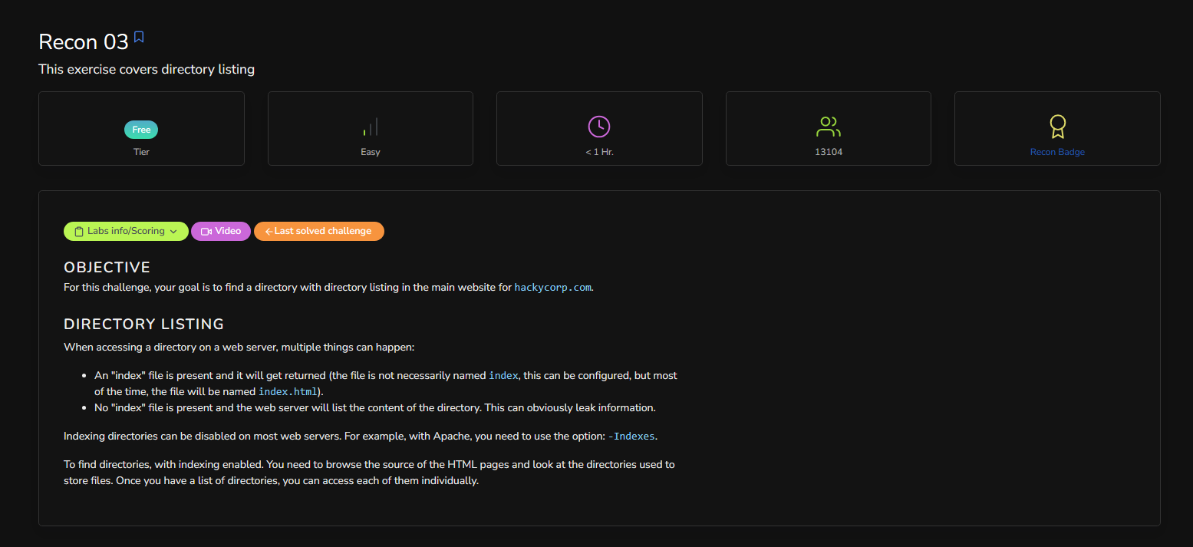
Notes:
Recon 03

Slide 18
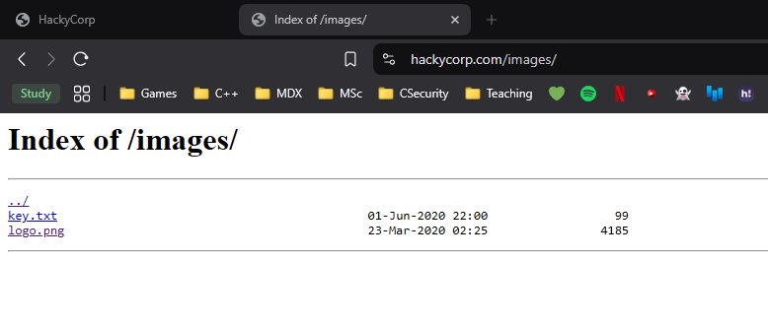
Notes:
Recon 03

Slide 19
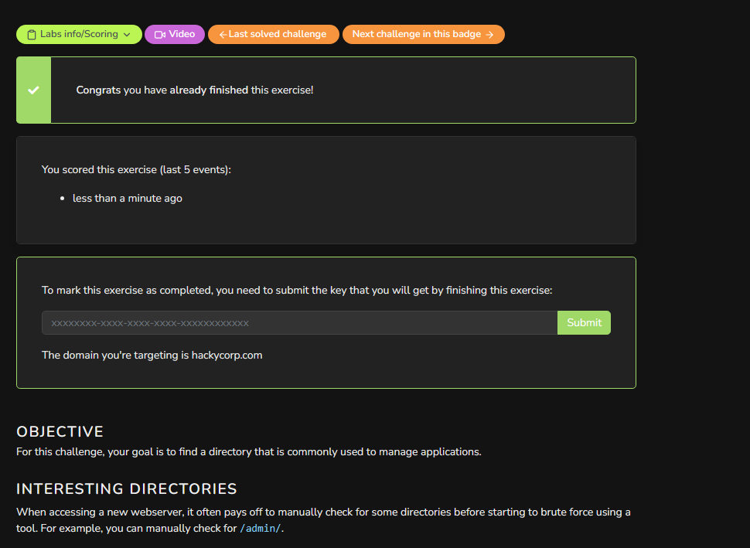
Notes:
Recon 03

Slide 20
Recon 04 (no help needed)
Notes:
Recon 04

Slide 21
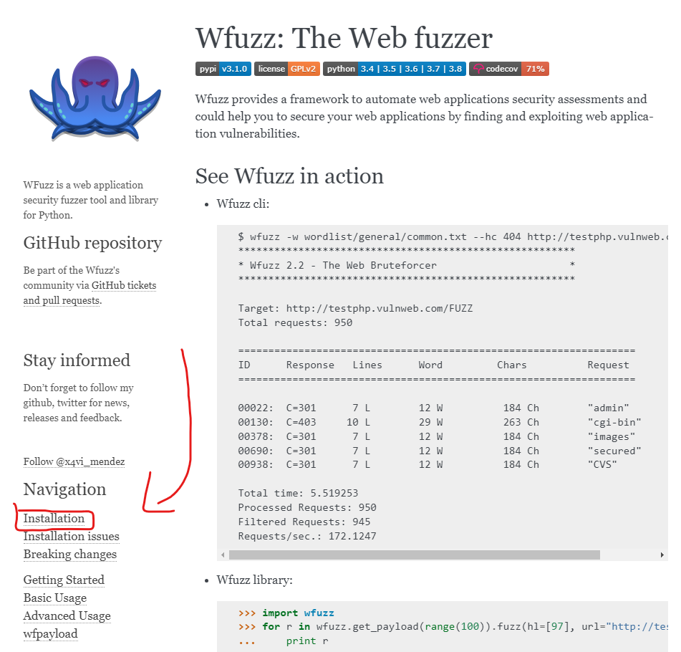
Make sure you’re in kali
Install Wfuzz: The Web fuzzer
Notes:
Recon 05

Slide 22
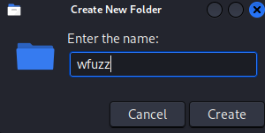
Cd into this new folder and paste the git clone
Notes:
Recon 05

Slide 23
If you get an error
This is prob due to the git:// protocol being blocked by your network or firewall
Notes:
Recon 05

Slide 24
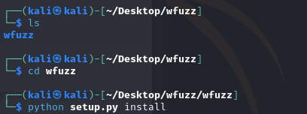
Python setup.py install
Notes:
Recon 05

Slide 25
Update Error?
Do nano setup.py
Notes:
Recon 05

Slide 26
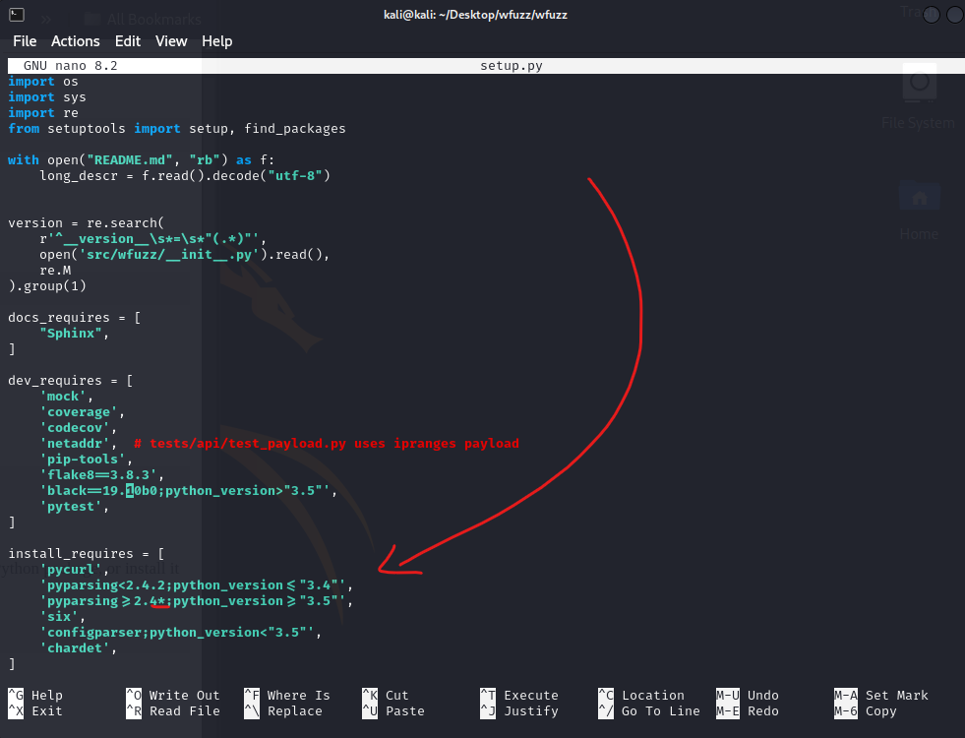
Remove *
Make sure your cursor is on the ; then
press ‘backspace’
Notes:
Recon 05

Slide 27
Error priv fix
If it again doesn’t work, just do sudo as the directory has priv on it
Notes:
Recon 05

Slide 28
Notes:
Recon 05

Slide 29
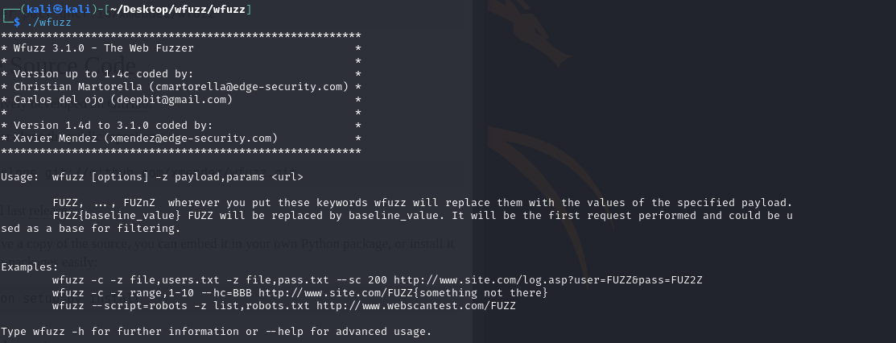
Notes:
Recon 05

Slide 30
Wfuzz comes with a couple wordlists
Notes:
Recon 05

Slide 31
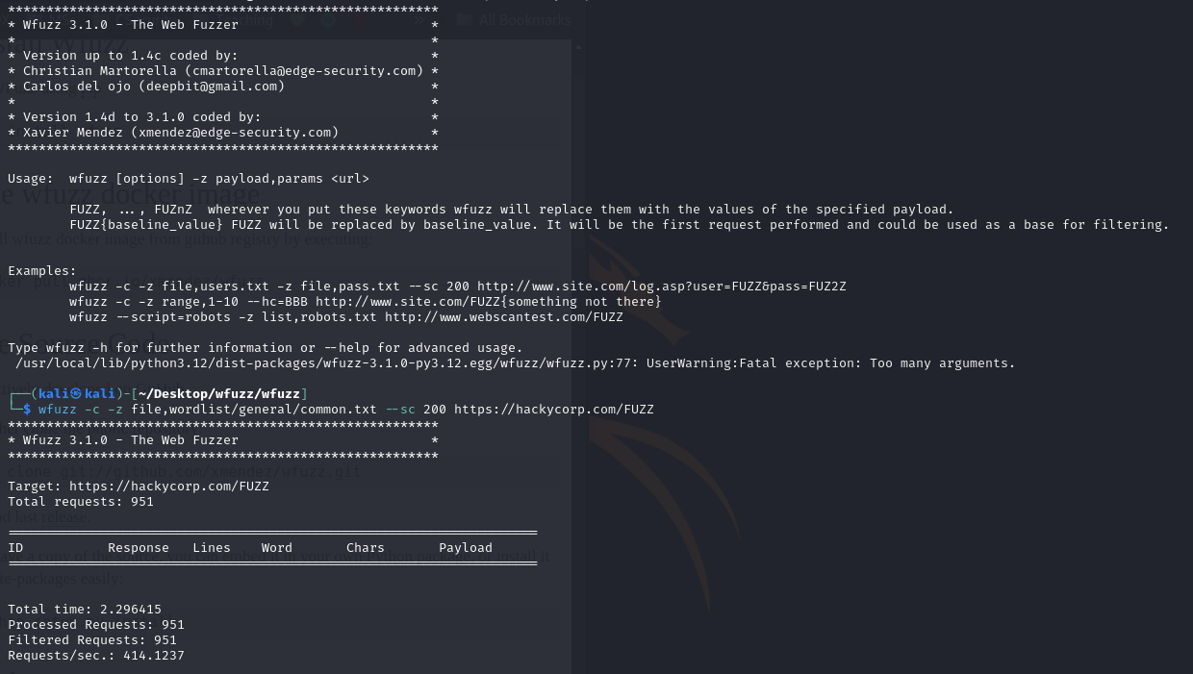
Notes:
Recon 05

Slide 32
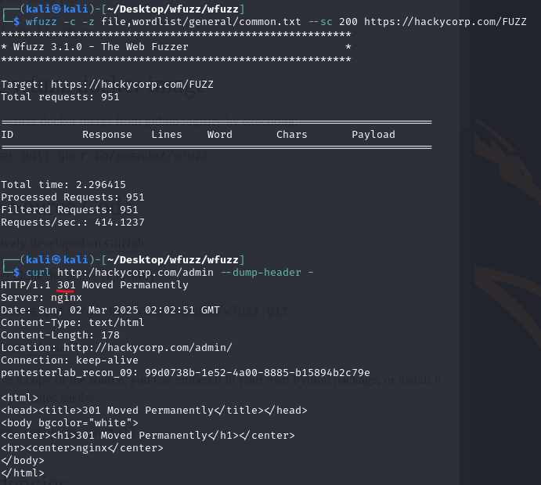
Notes:
Recon 05

Slide 33
curl http:/hackycorp.com/admin --dump-header –
Our command needs to specify “/” as we are being directed to 301 instead of 200 (which we want)
Update our command:
curl http:/hackycorp.com/admin/ --dump-header -
Notes:
Recon 05

Slide 34
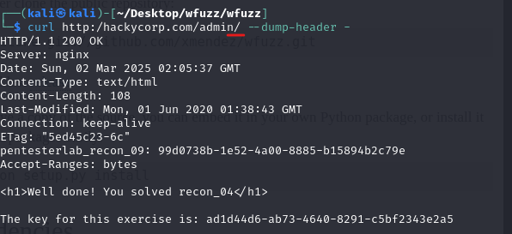
Notes:
Recon 05

Slide 35
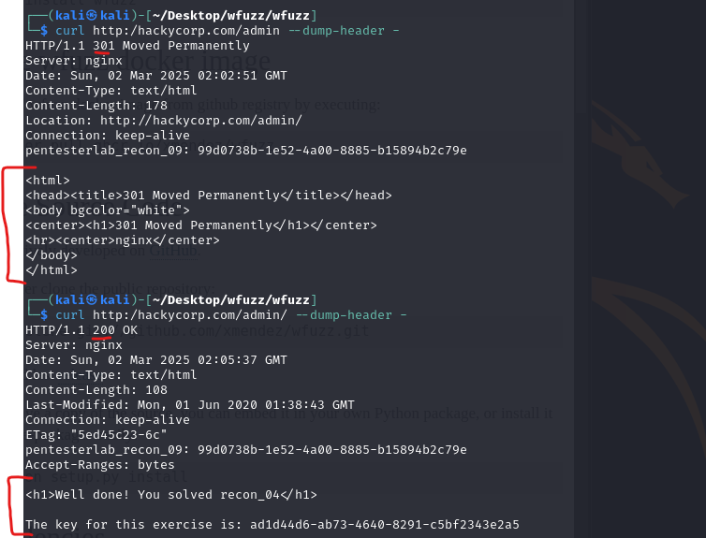
Flag obtained
Notes:
Recon 05

Slide 36
Ok… but wtf?
So our original command: └─$ wfuzz -c -z file,wordlist/general/common.txt --sc 200 https://hackycorp.com/FUZZ
It used 200, we could specify 301 to get it working, but what we can do instead is specify what we don’t want, for example 404
wfuzz -c -z file,wordlist/general/common.txt --hc 404 https://hackycorp.com/FUZZ
Notes:
Recon 05

Slide 37
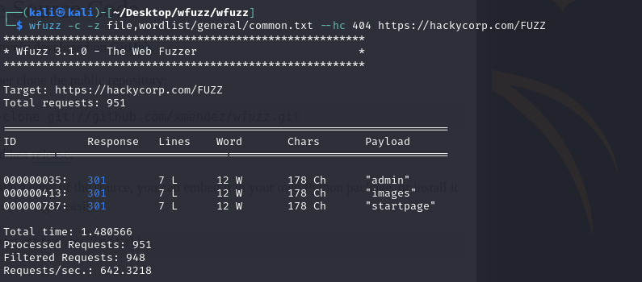
Works, now we have the brute force working
Notes:
Recon 05

Slide 38
Why was that important?
Manual testing is important to make sure your tools and testing is correct and gives a clean and clear output. But the Wfuzz force automation is still a valid way if you want a dirty output
Notes:
Recon 05

Slide 39
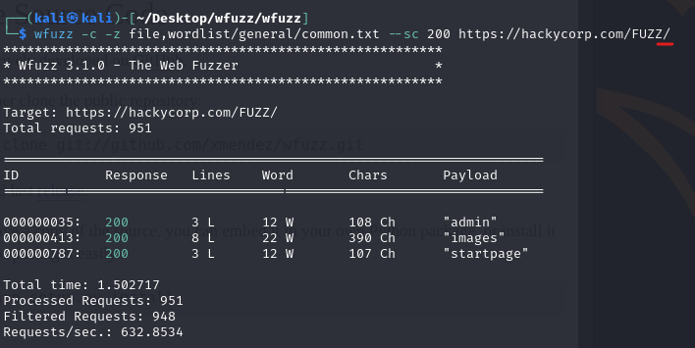
Example just to show you that searching in and out of a directory changes what happens
Notes:
Recon 05

Slide 40
After finding our responses payloads, curl it, and find your key
Notes:
Recon 05

Slide 41
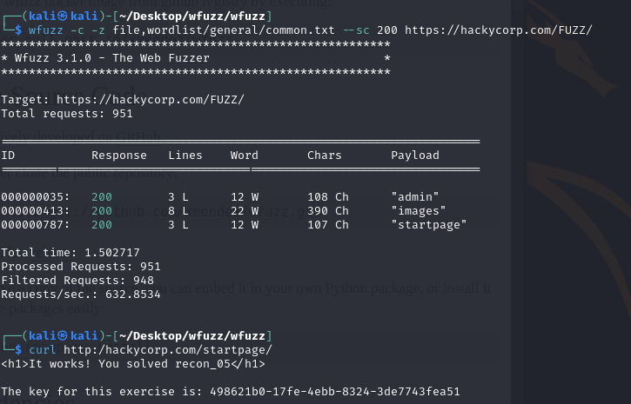
Notes:
Recon 05

Slide 42
Notes:
Recon 06

Slide 43
Couple things we need, IP address and curl.
Two options
Ping host
Dig host
Notes:
Recon 06

Slide 44
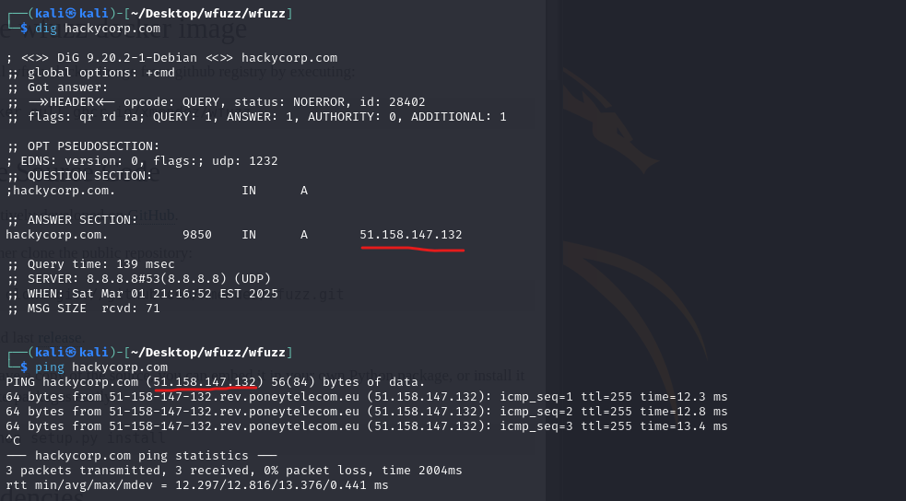
Notes:
Ping is easier to remember but dig gives you more advanced info
Recon 06

Slide 45
Notes:
Recon 06

Slide 46
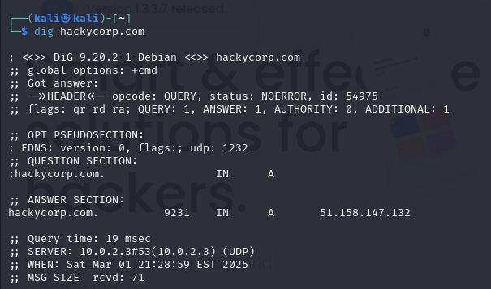
Remove wrapper (https://)
Notes:
Recon 07

Slide 47
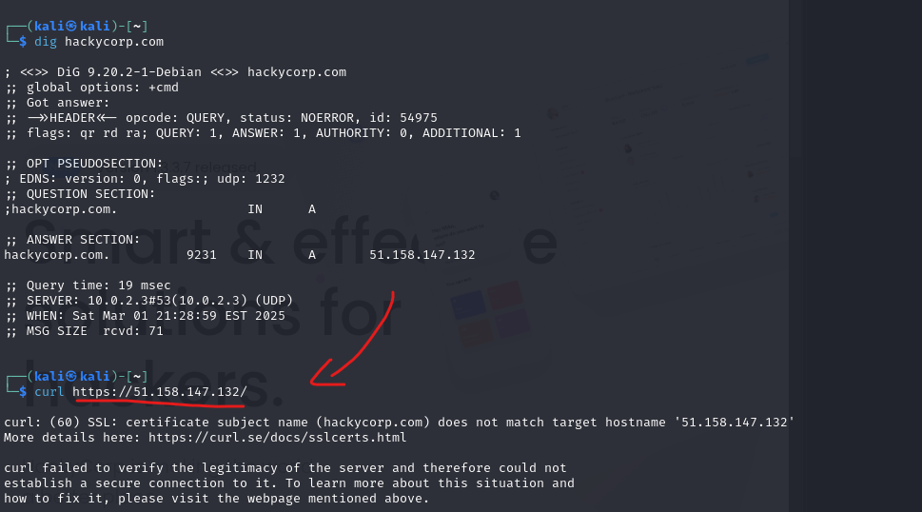
Use curl on the dig ip
Notes:
Recon 07

Slide 48
certificate subject name does not match target hostname
What is a website certificate?
An SSL certificate is a digital certificate that authenticates a websites identity and enables an encrypted connection.
SSL stands for Secure Sockets Layer, which is a security protocol that creates an encrypted link between a web server and a web browser
Notes:
Recon 07

Slide 49
certificate subject name does not match target hostname
So why did the command fail?
Well it’s because you wouldn’t certify the websites ip address, but instead the website domain name, for this case ‘hackycorp’
The reason it’s failing is because the IP is not certified and so will automatically default to an error to protect us.
We can bypass this by using the flag --insecure
Notes:
Recon 07

Slide 50
Notes:
Recon 07

Slide 51
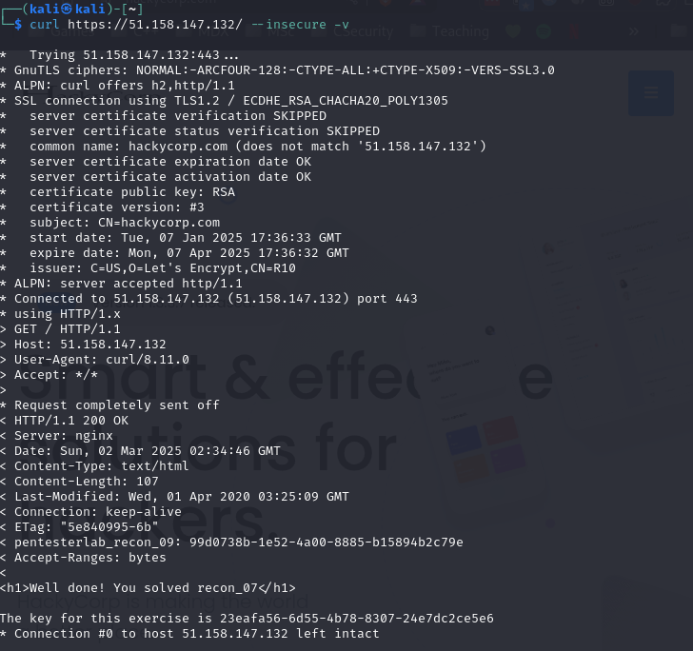
Notes:
-v for variables
Recon 07

